Slide 1
Pencil and paper data
Brad Sollenberger – OSI

Slide 2
Defining the problem
Problem - Good data is hard to find

Slide 3
Defining the problem
Problem
ROI – Pre and Post implementation deltas
Impact – FTE hours, Cycle Times
Causes
Cycle times exist, but not all the time
Process times rarely exist
Not every change has a Kaizen (so not even SME best guesses)
Most units don’t have capacity or resources to dedicate for direct observation (and SMEs don’t necessarily want to be directly observed either)
What can we do?
Utilize existing Lean tools (Operator Worksheet AKA the Process Observation Form)
Directly Observe or Distribute the data collection burden
Engage SMEs already committed to the initiative
Use more accurate data process reviews with Kaizen engagements

Slide 4
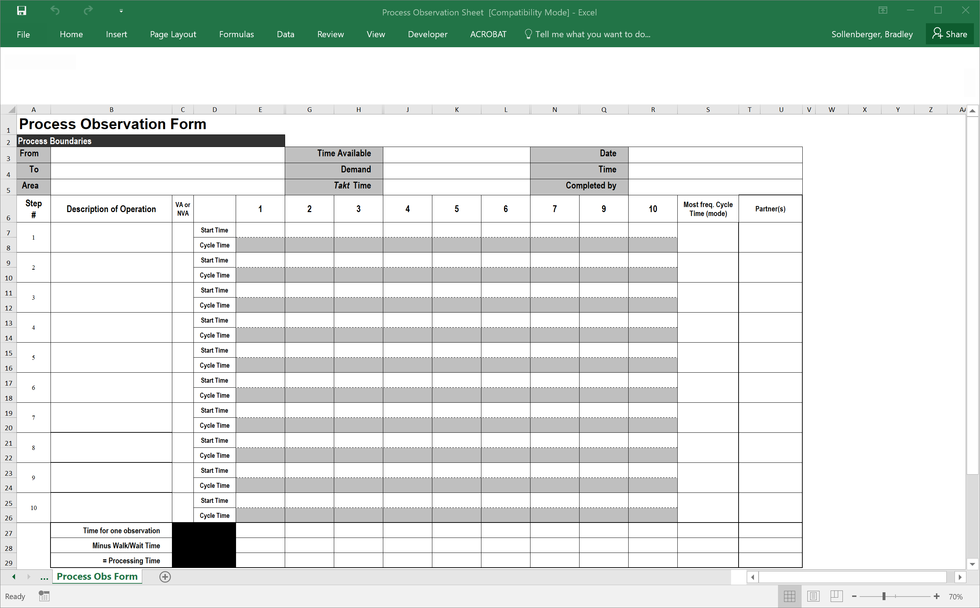
Components of A process observation worksheet
WHERE
HOW OFTEN
WHEN
WHO
WHAT
# of Observations
WHO
PROCESS TIMES

Slide 5
Components of A process observation worksheet
Start time #2 - #1 = Wait Time
Between steps
Total wait times

Slide 6
When to use a process observation worksheet
When data isn’t available at all
When cycle time is (automated timestamps), but process time isn’t understood
When data can’t be trusted
When data is blended, not easily stratified
When you want front line engagement

Slide 7
Benefits of A process observation worksheet
Can help drill down into process data
PT, CT, Volume/Demand, Range, even Throughput Yield!
Tests assumptions of current state map activity
Clarifies responsibilities in current state map
Reveals differences in operator standard work
Creates awareness, engagement
All you need is a printer and pencil

Slide 8
When in gemba
Explain why you’re there – role and purpose
Reassure the person you will be observing/interviewing
Focus on the process, not the people performance
Just observe, do not criticize
Save 10 minutes to discuss Process Observation Worksheet

Slide 9
Exercise – Learning how to make and use Process Observation worksheet
Brad has a process for us to learn about and observe….
Questions to ask?
What triggers the process? What is the output?
Who is involved?
High-level, explain it in 30 seconds
Observe once
Observe twice and document
Hm, yes. This process appears to be made of process…

Slide 10
Notes:
Option 1 - granular
Open square app
Select invoices from navigation screen
Select create invoice
Add customer name and email address
What if new customer?
Select from existing list of clients
Select item from item library
Enter quantity
Add invoice details
Add message
Preview invoice
Customize look of invoice
- edit message text
- edit color
- edit image
Edit invoice? Edit and click save
Click send
Option 2 – High-level
Create existing customer invoice
Create new customer invoice
Edit invoice

Slide 11
Comparing notes
Step | Activity (Granular)
1 | Open app, select “Invoices”
2 | Click “Create Invoices”
3 | Enter customer name and address
4 | Select purchase item from item library
5 | Enter quantity
6 | Add invoice details (comments)
7 | Customer message (optional)
8 | Preview Invoice
9 | Customize Invoice
10 | Send
Step | Activity (High Level/Grouped)
I | Create Existing Customer Invoice
II | Create New Customer Invoice
III | Edit Invoice
Step | Exemptions
3.A | Create new customer record
9.A | Edit Invoice
10.A | Click “Save” then Send

Slide 12
Explaining the Process Observation Worksheet
Explain why this is being collected
“This is to reflect the process, not your performance in any way”
“We will use this to compare and evaluate efficiencies against the new system”
“We are looking to capture touch time and cycle time
Explain how to collect it
“Keep track of the waiting time”
“Use a stop watch, app, or the clock”
“3 different observation periods (different time of day, day of week) with 10 consecutive observations in each period is ideal”
“Be as accurate as possible”
Additional reassurance may be needed here – Give praise… reiterate it’s only 30 observations… “Don’t stress over being perfect – directionally correct is all we need”
If resistant
Be flexible, if appropriate
Engage other staff, or work with them on alternatives – direct observation

Slide 13
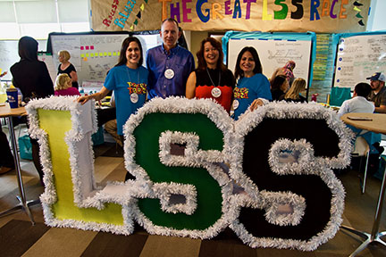
Connecting Process maps with Process Observations
Day of Gemba
Go to Gemba/SME Interviews
Observe/Document the Process
Teach the Process Observation Worksheet
Data Collection Prep
Refine/Validate Current State
Create Process Observation Worksheet based on map boxes
(Be sure to leave some blank “Description of Operation” spaces available)
Send to SME
Synthesis
Collect Data
Enter onto Current State Map

Slide 15
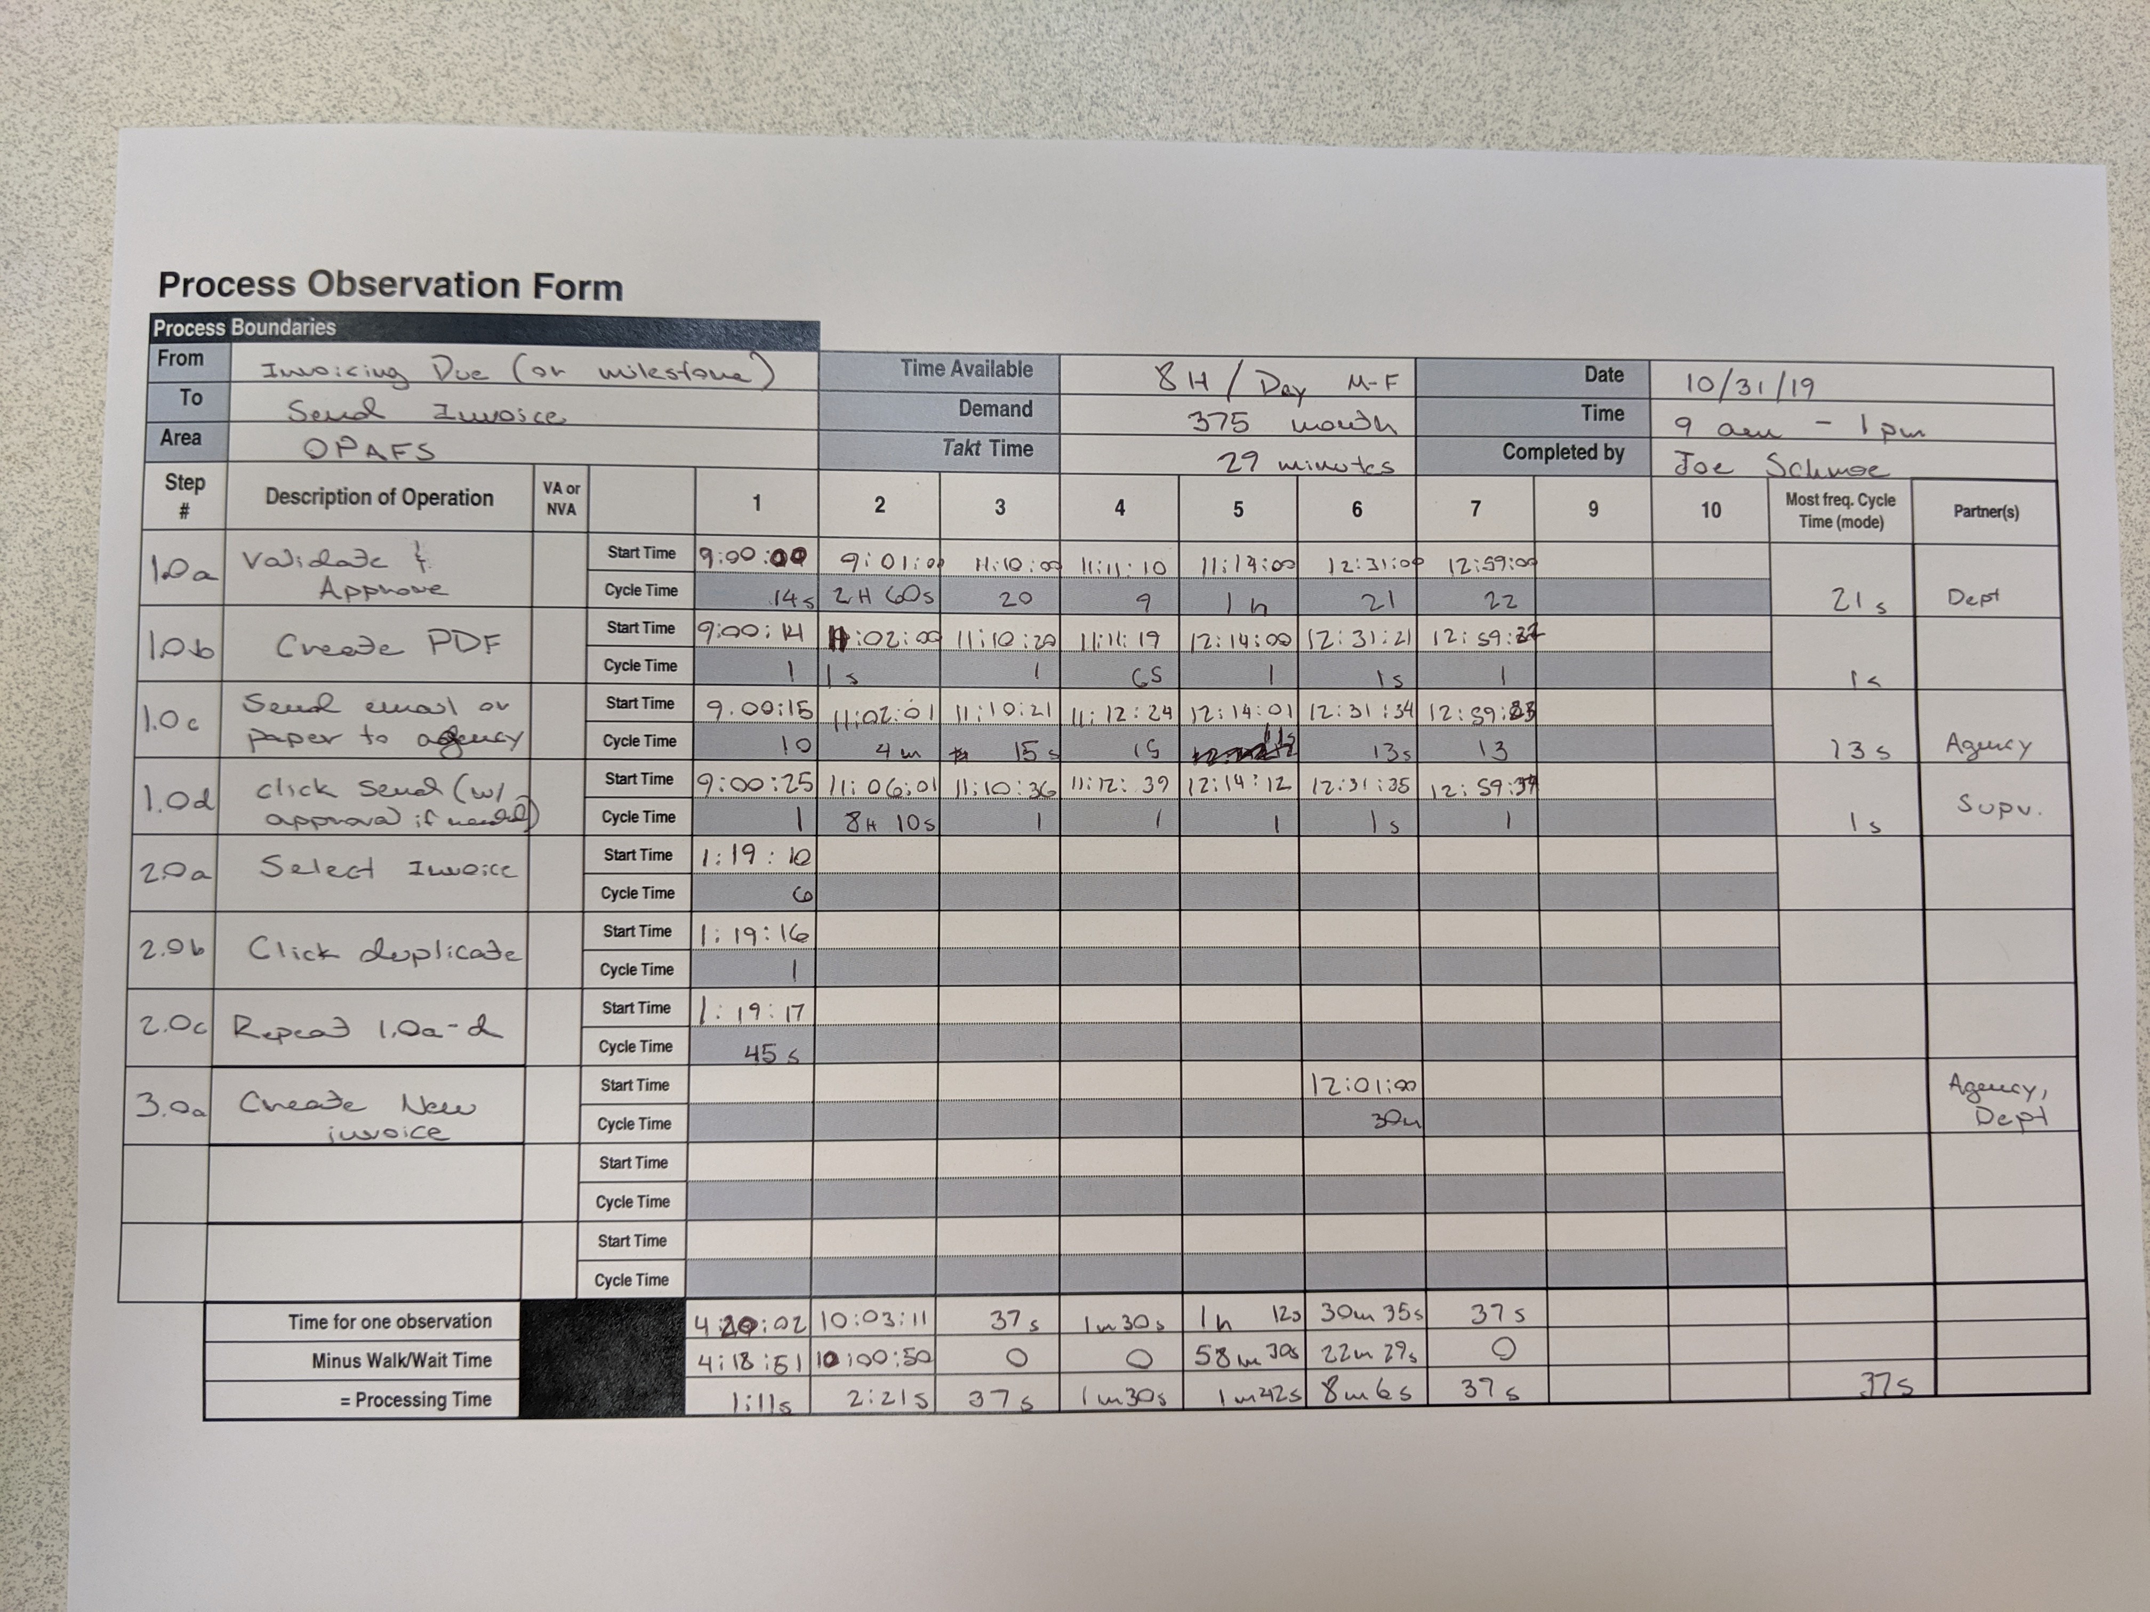

Slide 16
Types of data defined
Process Time = “Touch” time
Cycle Time = Process Time + Wait time
Workflow timestamps are a good example
Lead Time = Sum of all cycle times from input to output
Throughput Yield = % of time the product progresses in the process, or an exception occurs
Decision diamonds on the current state map

Slide 17
Volume = 7 invoices per day
Create New Invoice? TPY:
14.3% (NO) 85.7% (YES)
Revision Req’d? TPY:
14.3% (NO) 85.7% (YES)
Notes:
Yellow box is lead times, beneath that is the tracked and documented wait times, and then in the red box is process time or “touch time”
The light blue box will reveal average cycle times by step.
If you prepare your Process Observation Form well enough, and include exceptions, you can also get insight into the throughput yield, which is done here.

Slide 18
Adding data to your current state map
Step Data | PT | CT
1.0a | 21s | 26.14m
1.0b | 1s | 1.5s
1.0c | 13s | 37s
2.0a | 6s | 6s
2.0b | 1s | 1s
2.0c | 45s | 45s
3.0a | 450s | 30m
Process Data | Metric
Avg PT | 2m 17s
PT Range | 37s – 8m 6s
Avg LT | 2.27 hrs
LT Range | 37s – 10h 3m 11s
Avg Daily Volume | 7
Revision TPY | 14.3%
Custom TPY | 14.3%
Notes:
So now, a low-fidelity, inelligent form of data capture suddenly become as good as gold.
If you can’t do direct or recorded observation, distributing the work sheet for SME’s to essentially “grade their own homework” is a perfectly adequate proxy measure. If we were doing insanely refined manufacturing or research studies, maybe this doesn’t cut it, but for university administrative processes, this is perfectly acceptable and saves resources.

Slide 19
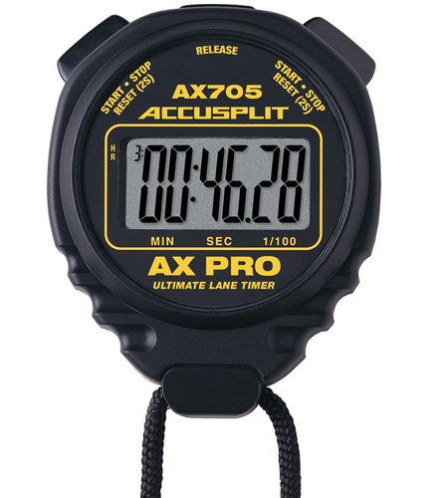
Final thoughts – tips and tricks
Be flexible
Start and End? Really?
“Happy Process,” then exemptions
You may have to observe yourself
Leave blank spaces
Level of granularity
Be ‘directionally correct’
Stop “Random acts of Kaizen”

Slide 20
Questions?
bsollenberger@ucsd.edu
Will post template and video at becop.ucsd.edu

